Slide 1
IDENTIFY COMPONENT
FROM WEBSITE

Slide 2

WEBSITE TO VISITE
https://www.passerellesnumeriques.org/en/

Slide 3
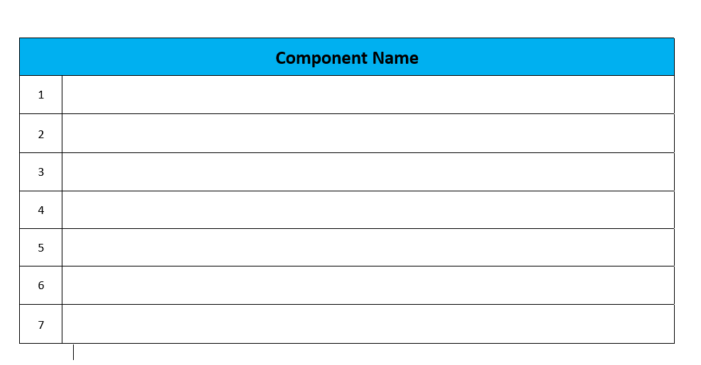
COMPONENT LISTS

Slide 4
WEB UI
COMPONENTS

Slide 5
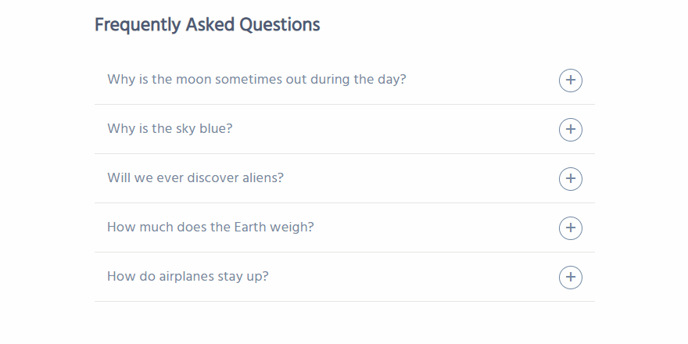
ACCORDION

Slide 6
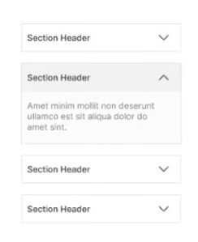
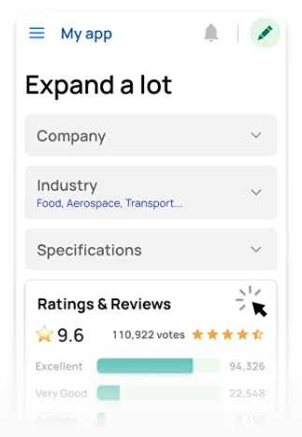
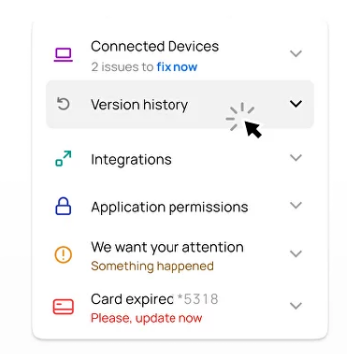
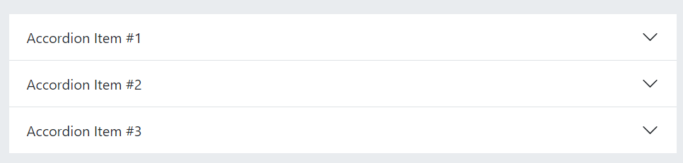
ACCORDIONS
More example
Read more:
https://pathumpmgux.medium.com/accordions-how-to-design-them-d3b397c9de07

Slide 7
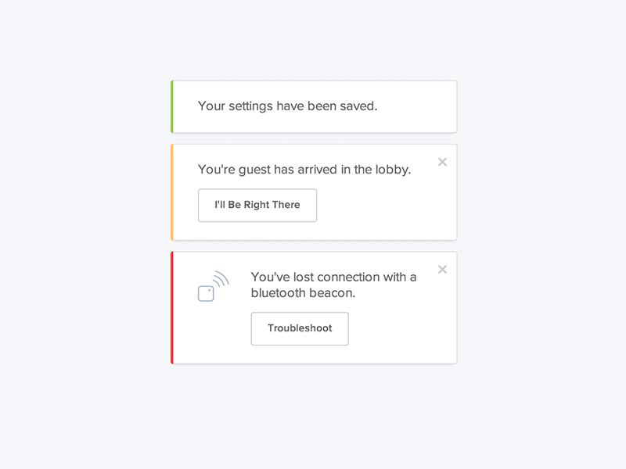
ALERT

Slide 8
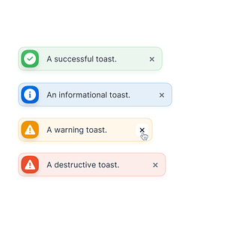

ALERT
More example

Slide 9
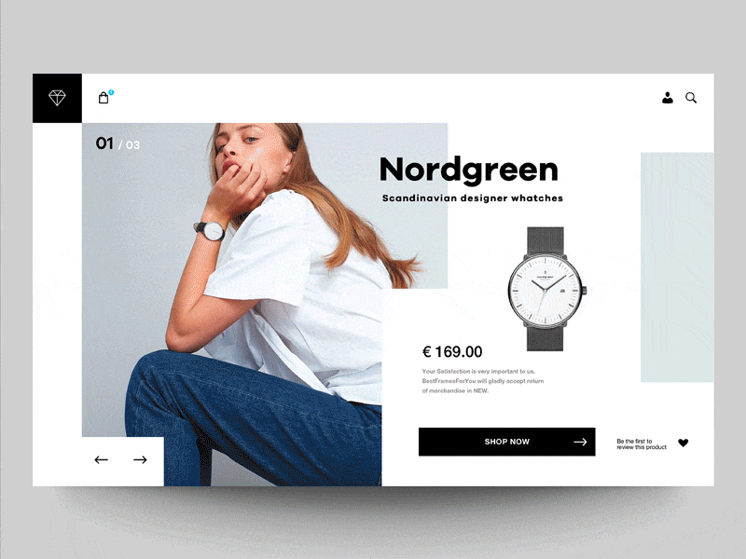
CAROUSEL
Notes:
CAROUSEL == slideshow

Slide 10
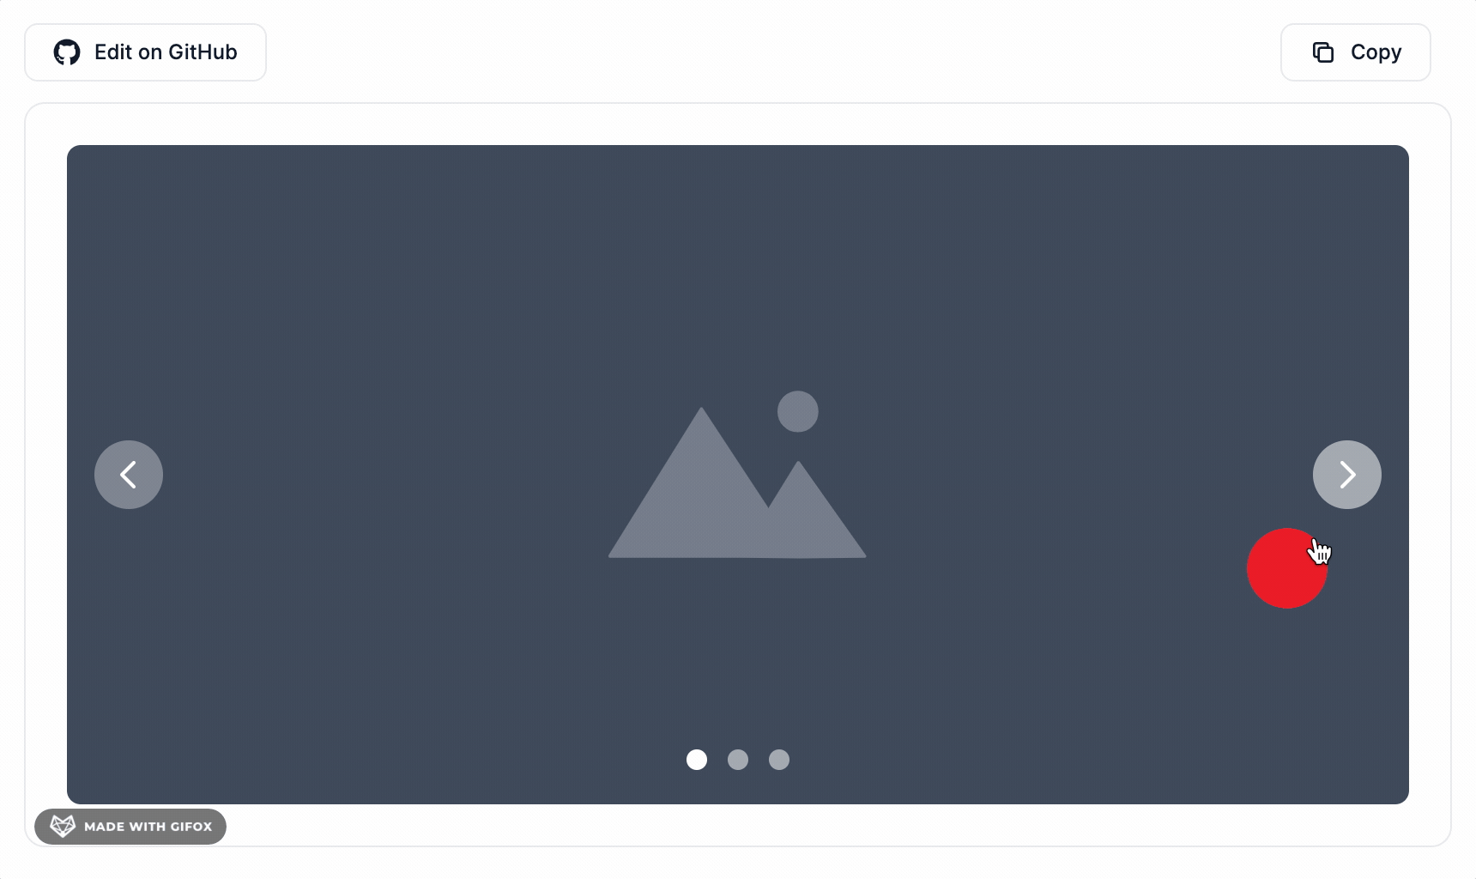
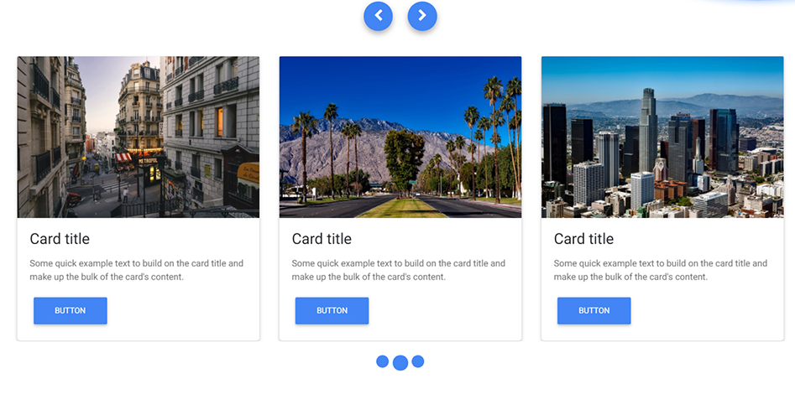
CAROUSEL
More example
Notes:
CAROUSEL == slideshow

Slide 11
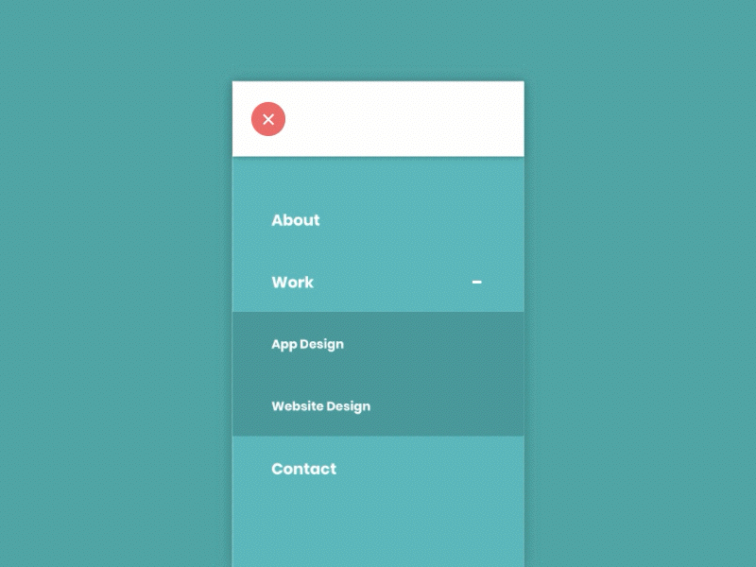
COLLAPSE
Notes:
Let's say, by collapsable section I mean like longer forms, you have sections that can be collapsed to have a more organised form and to hide unwanted sections for the time being. Accordion is more like FAQ. Sections does not close when you expand another section while accordion can only one be opened at same time.

Slide 12
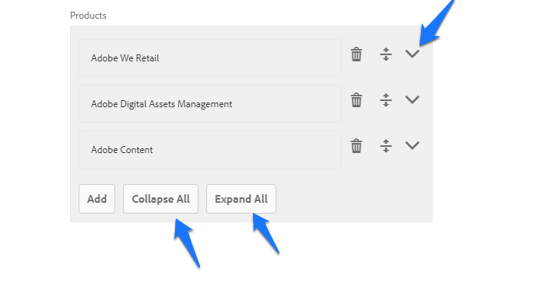
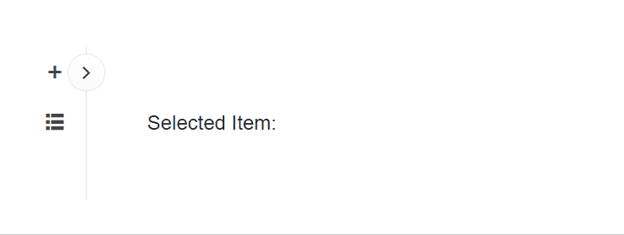
COLLAPSE
More example
Notes:
Let's say, by collapsable section I mean like longer forms, you have sections that can be collapsed to have a more organised form and to hide unwanted sections for the time being. Accordion is more like FAQ. Sections does not close when you expand another section while accordion can only one be opened at same time.

Slide 13
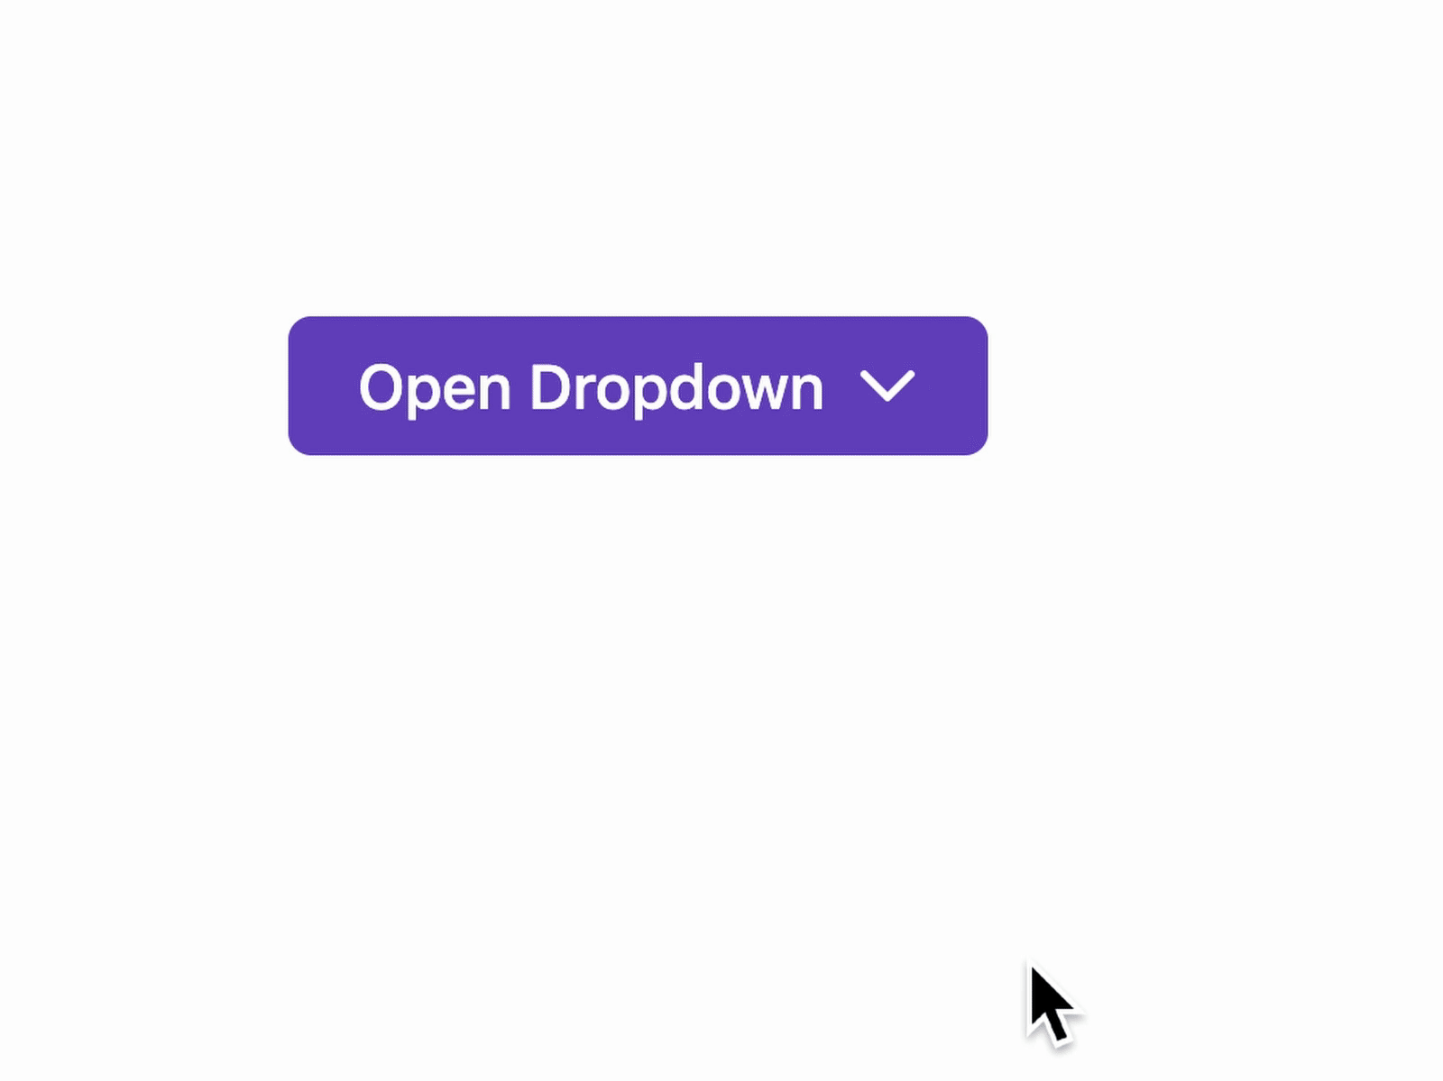
DROPDOWN

Slide 14
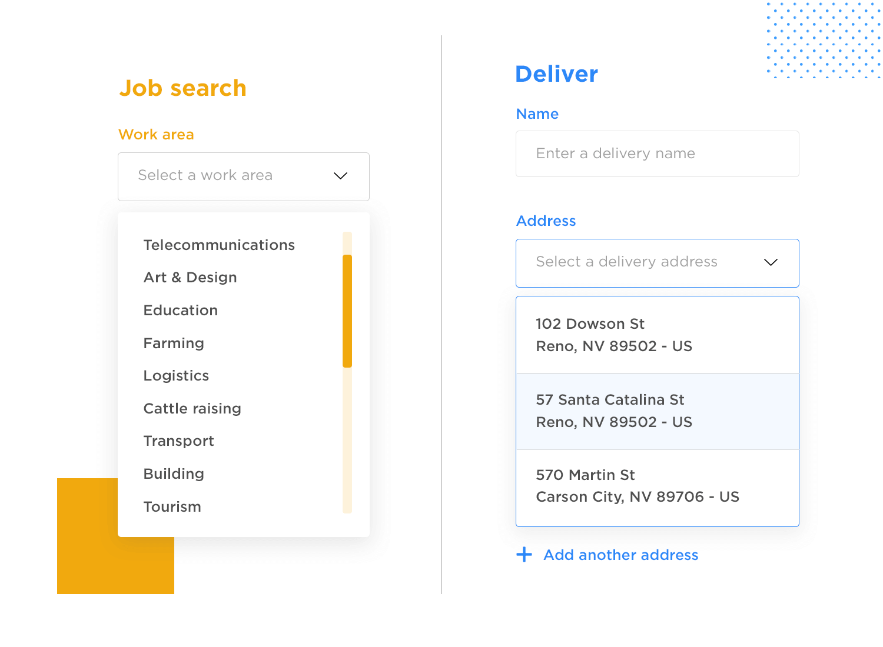
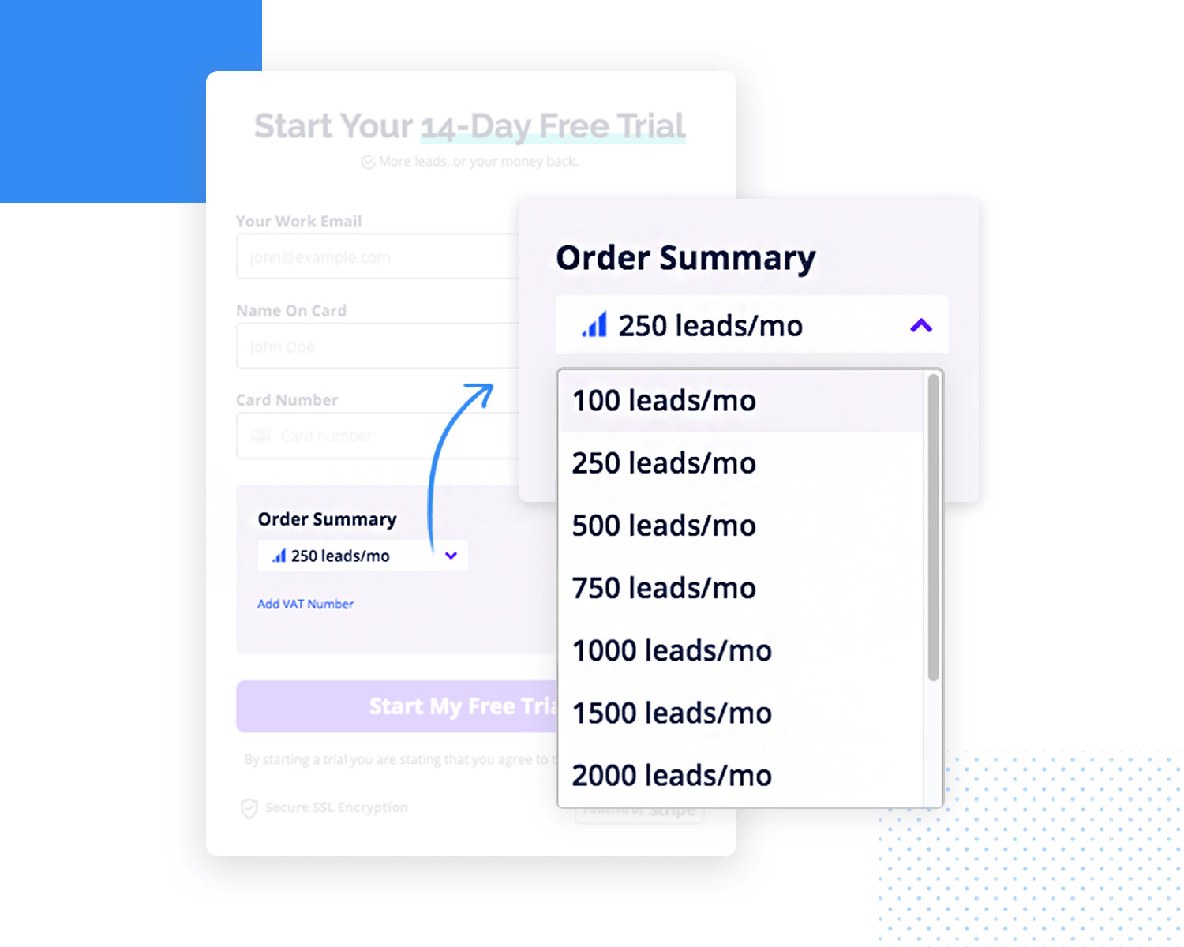
DROPDOWN
More example

Slide 15
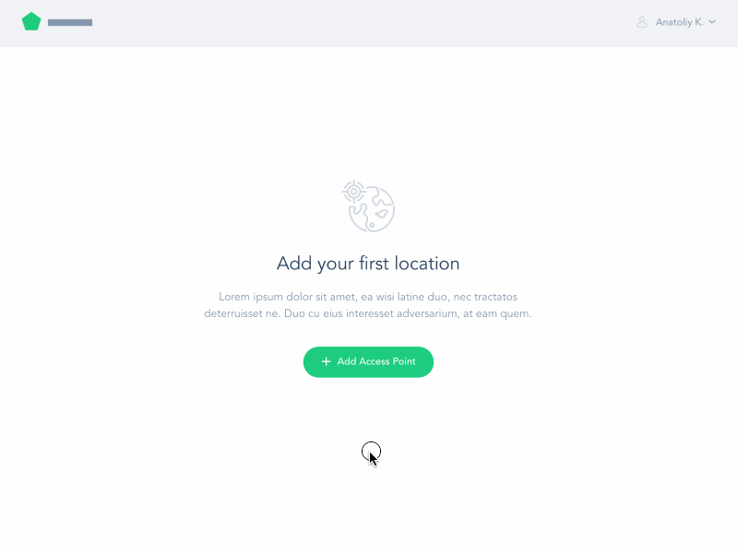
MODAL

Slide 16
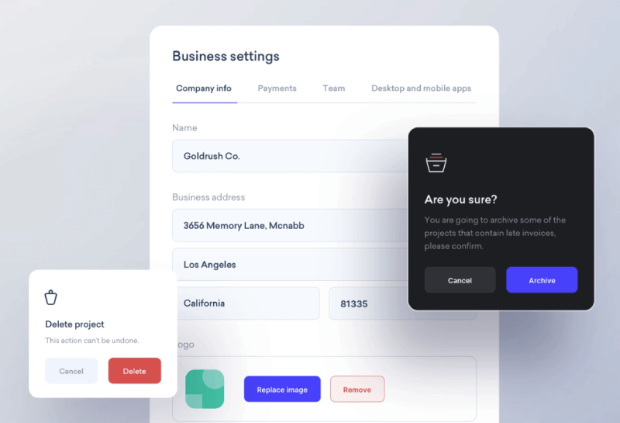
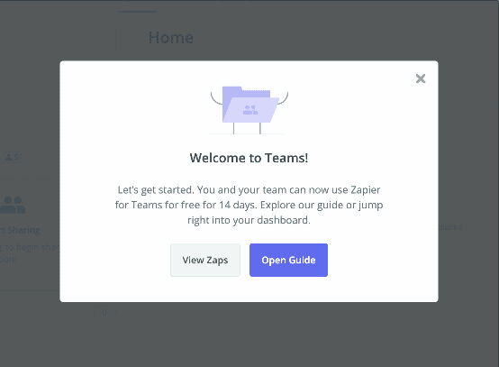
MODAL
More example

Slide 17

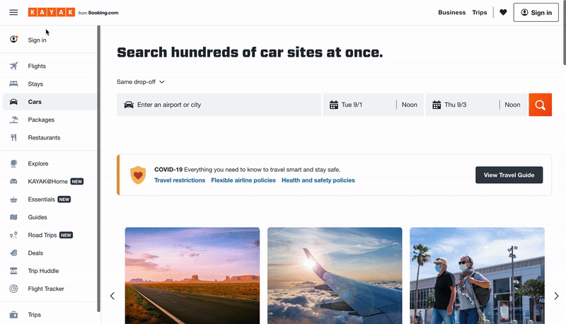
NAVBAR

Slide 18
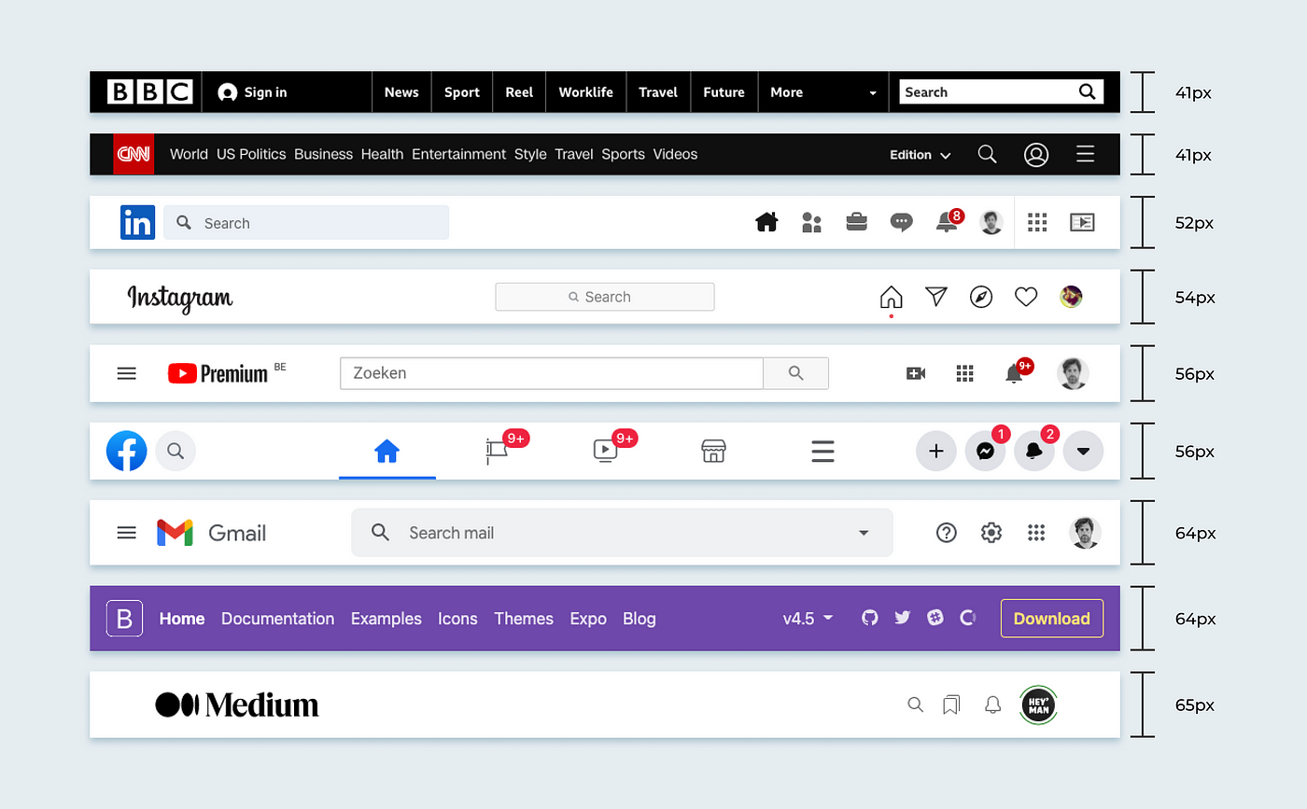
NAVBAR
More example

Slide 19
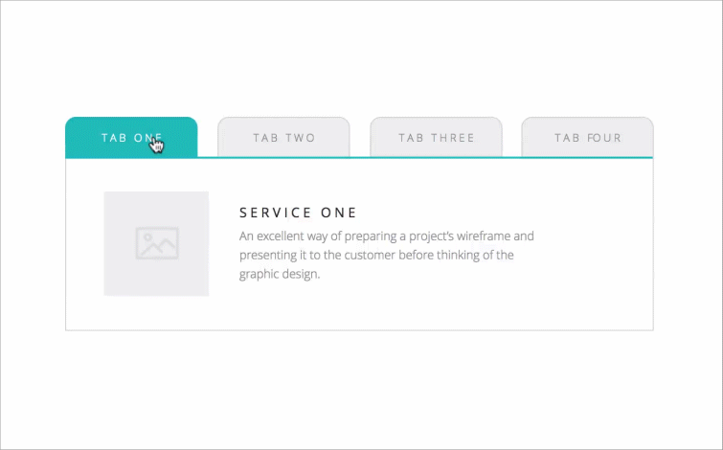
TAB

Slide 20
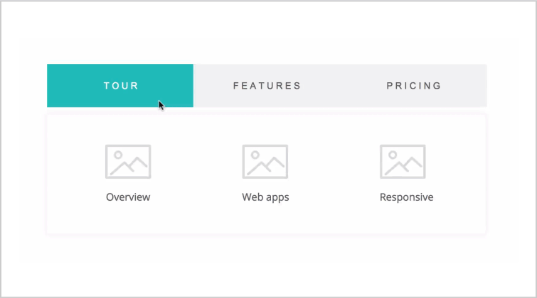
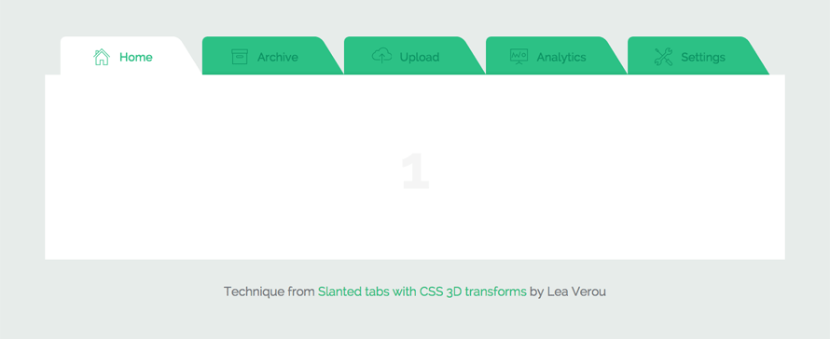
TAB
More example

Slide 21
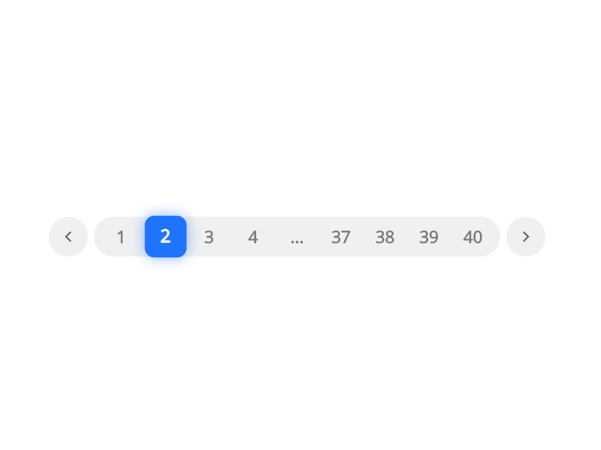
PAGINATION

Slide 22
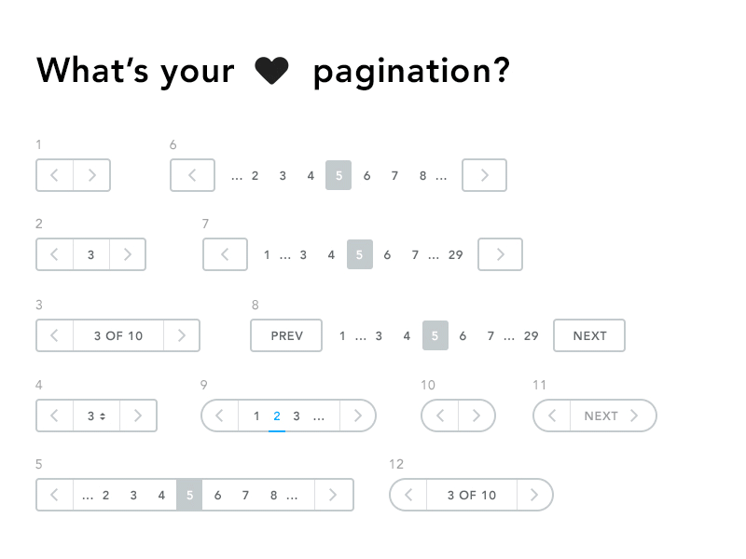
PAGINATION
More example

Slide 23
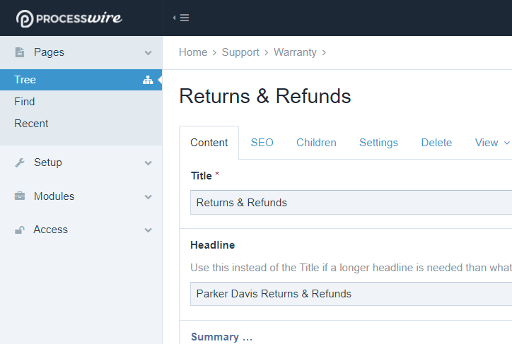
BREADCRUMB

Slide 24
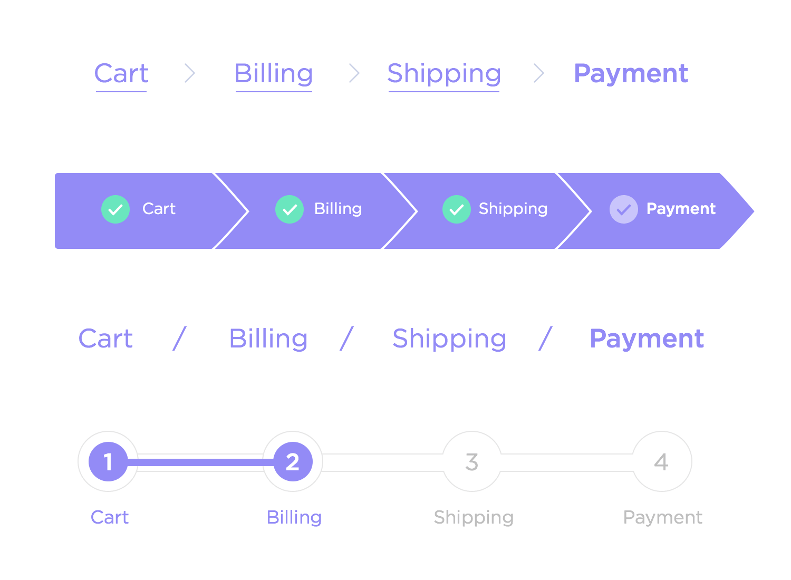
BREADCRUMB
More example

Slide 25
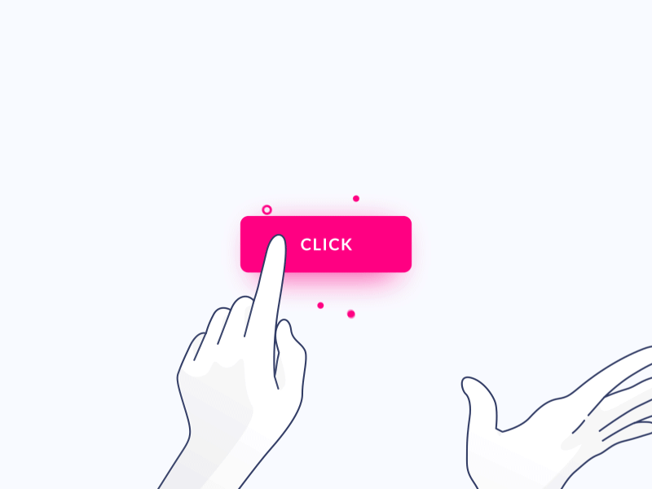
BUTTON

Slide 26
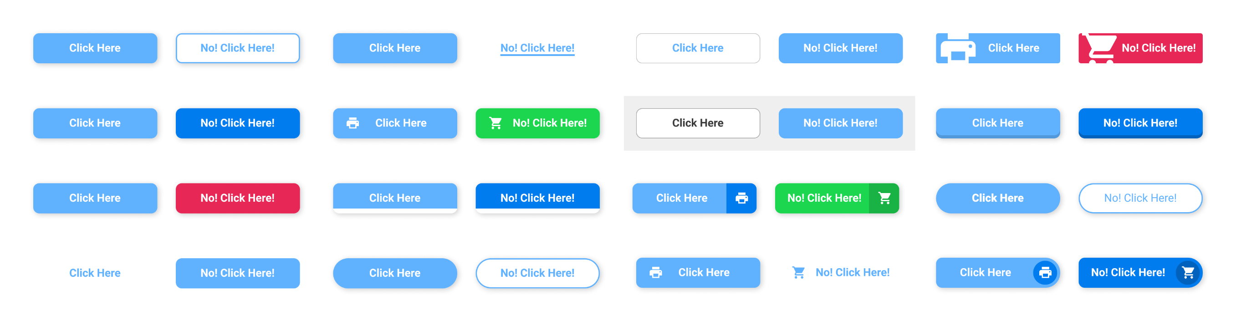
BUTTON
More example

Slide 27
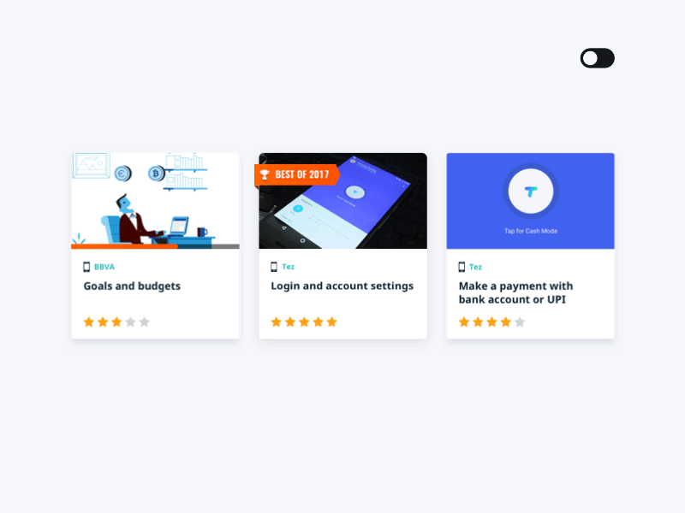
CARD

Slide 28
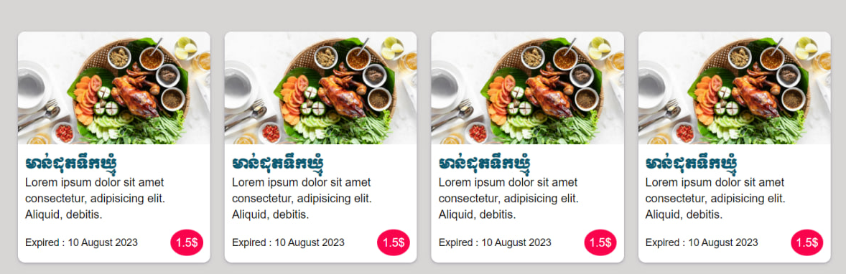
CARD
More example

Slide 29
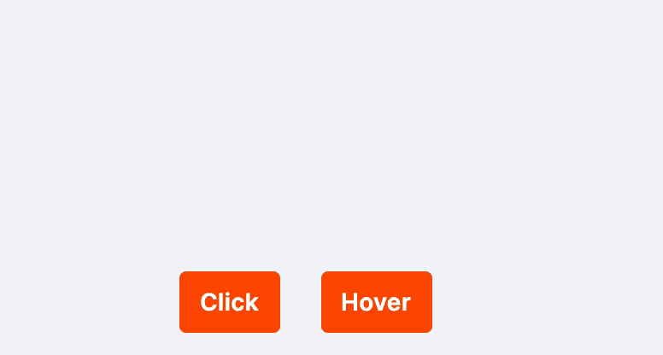
POPOVER

Slide 30
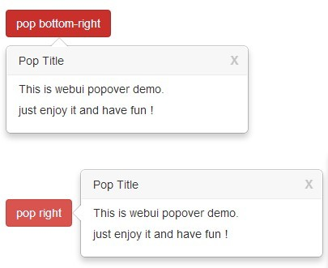
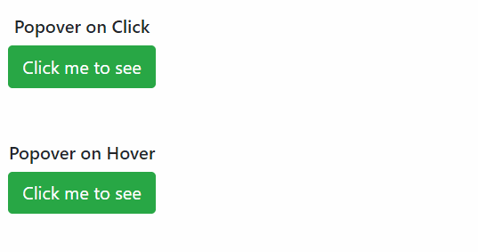
POPOVER
More example

Slide 31

SPINNERS

Slide 32
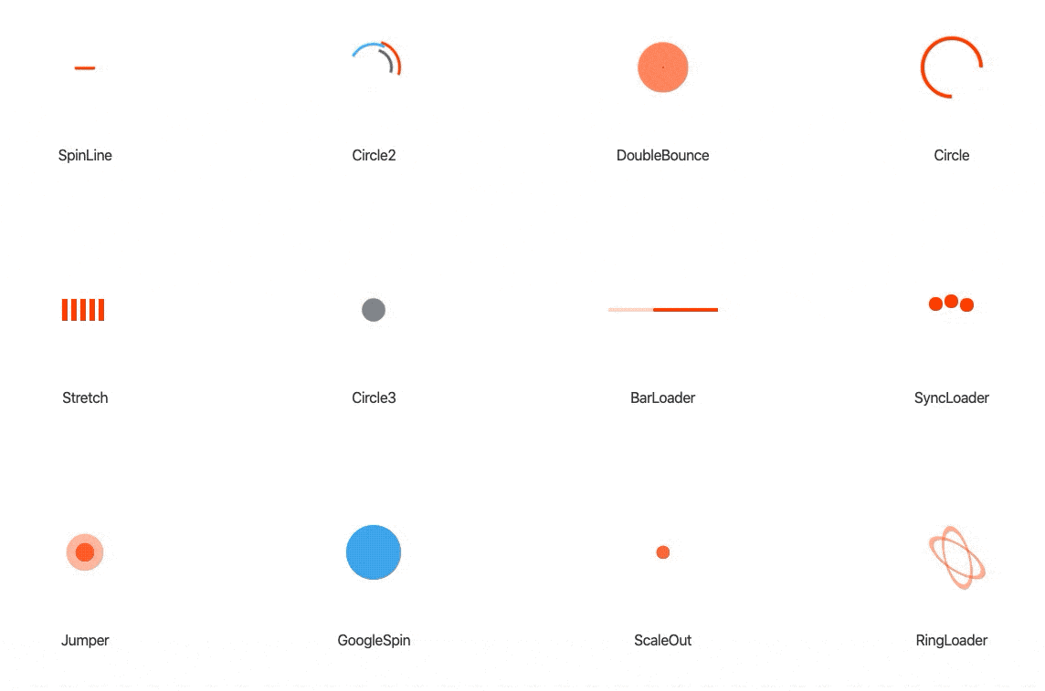
SPINNERS
More example

Slide 33

ICON

Slide 34
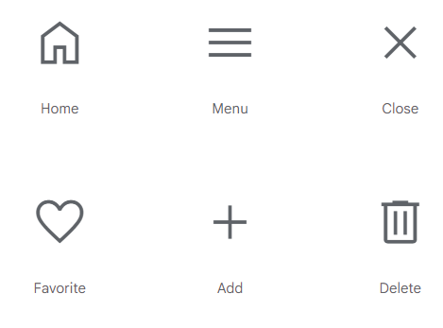
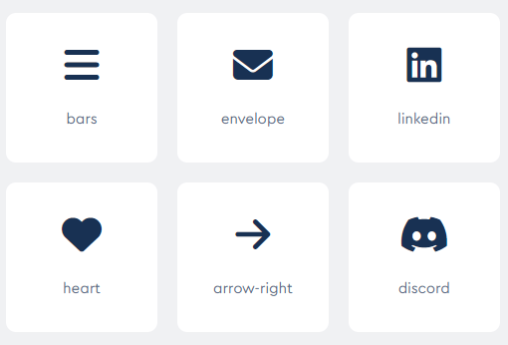
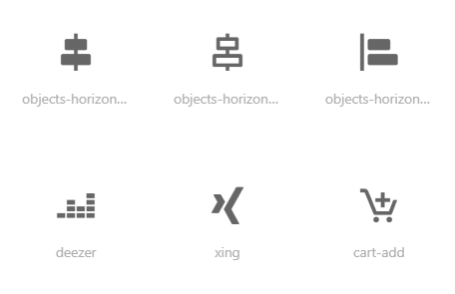
ICONS
More example
Google Icons
Font Awesome Icons
Box icons
Notes:
https://fonts.google.com/icons
https://materializecss.com/icons.html
https://www.w3schools.com/icons/
- https://boxicons.com/

Slide 35
https://getbootstrap.com/docs/5.3/components/accordion/
MORE COMPONENTS

